Slide 1


Digital Music store analysis by using SQL

Slide 2
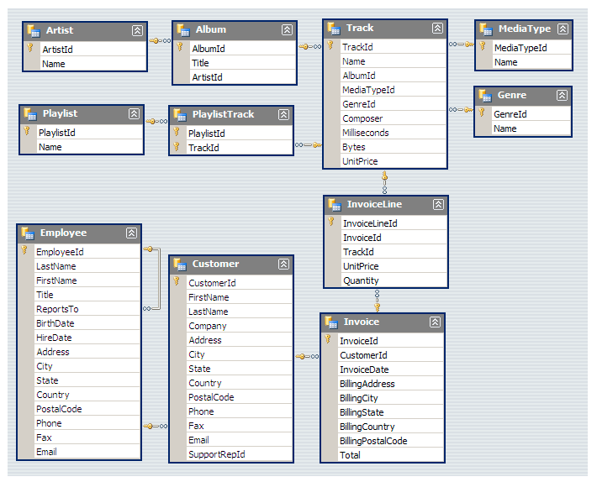
schemas

Slide 3
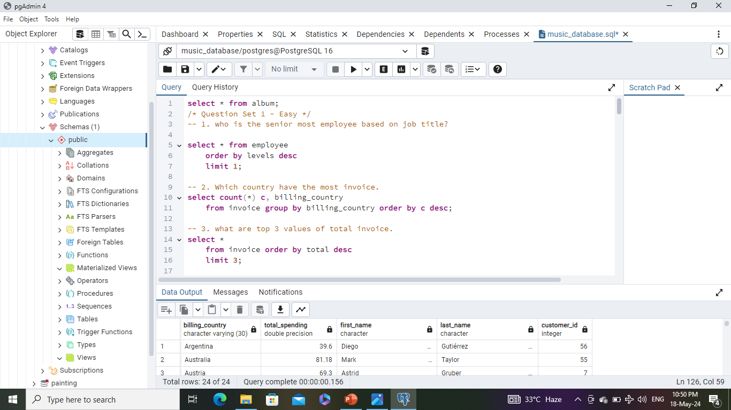
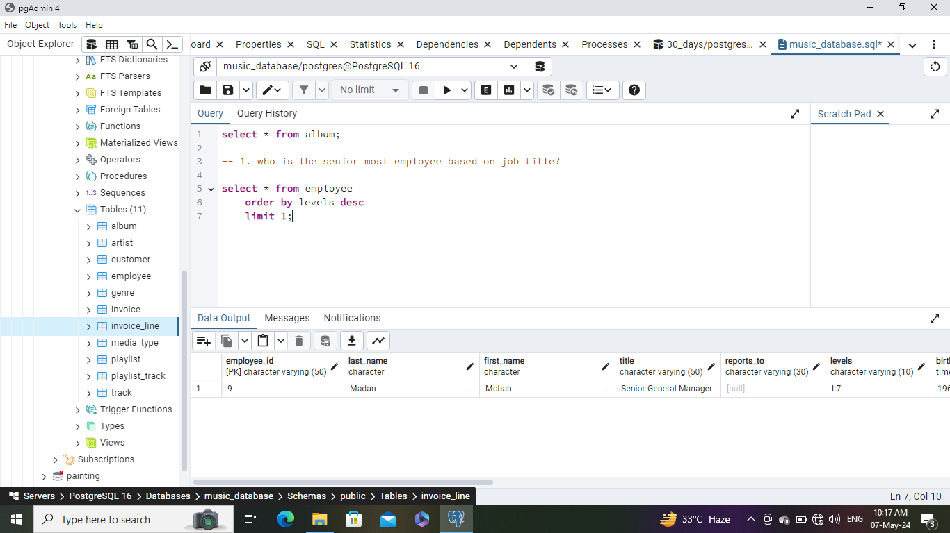
Question Set 1 - Easy
1. who is the senior most employee based on job title?
Query-
Out Put-

Slide 4
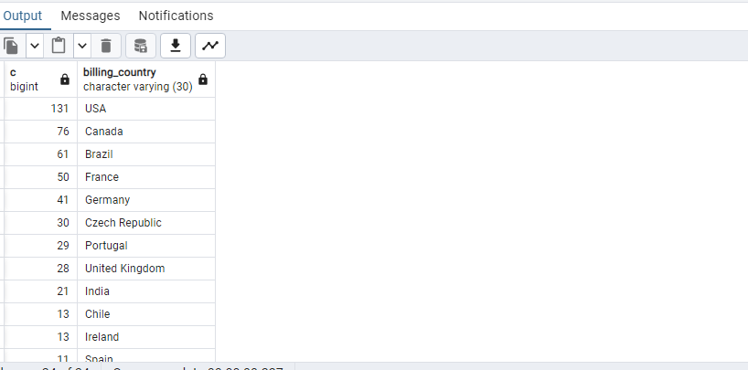
Question Set 1 - Easy
2. Which country have the most invoice.
Query-
Out Put-

Slide 5
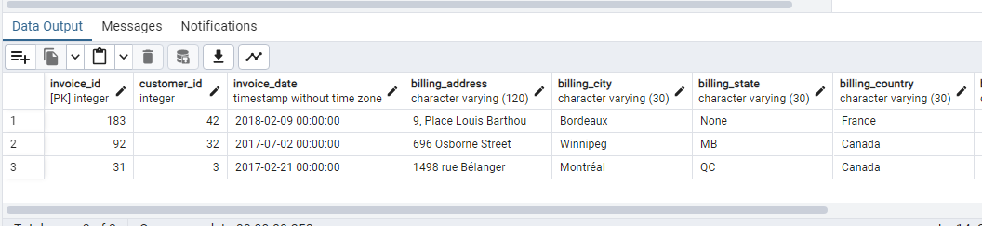
Question Set 1 - Easy
3. what are top 3 values of total invoice.
Query-
Out Put-

Slide 6
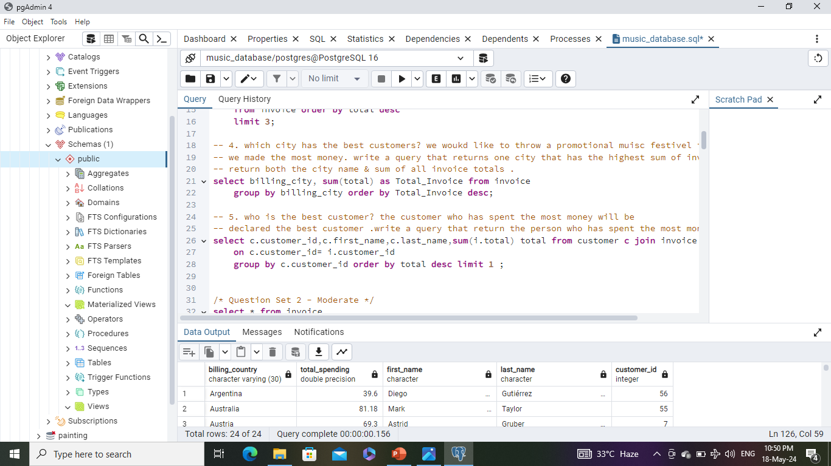
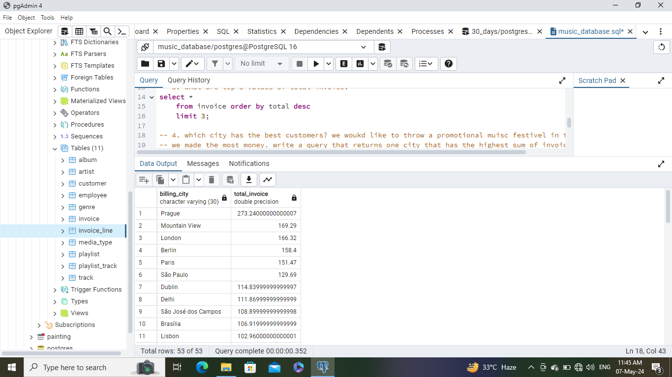
Question Set 1 - Easy
4. which city has the best customers? we would like to throw a promotional music festival in the city we made the most money. write a query that returns one city that has the highest sum of invoice totals. return both the city name & sum of all invoice totals.
Query-
Out Put-

Slide 7
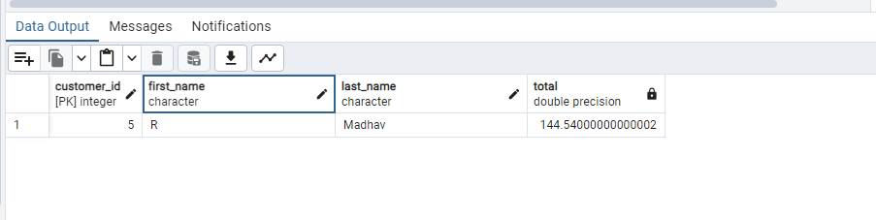
Question Set 1 - Easy
5. who is the best customer? the customer who has spent the most money will be declared the best customer .write a query that return the person who has spent the most money.
Query-
Out Put-

Slide 8
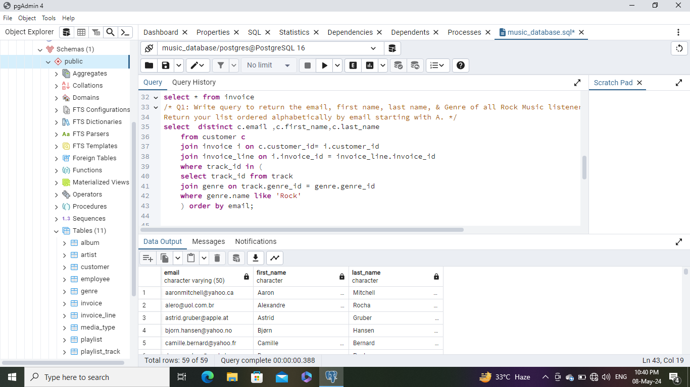
Question Set 2 - Moderate
1: Write query to return the email, first name, last name, & Genre of all Rock Music listeners. Return your list ordered alphabetically by email starting with A.
Query-
Out Put-

Slide 9
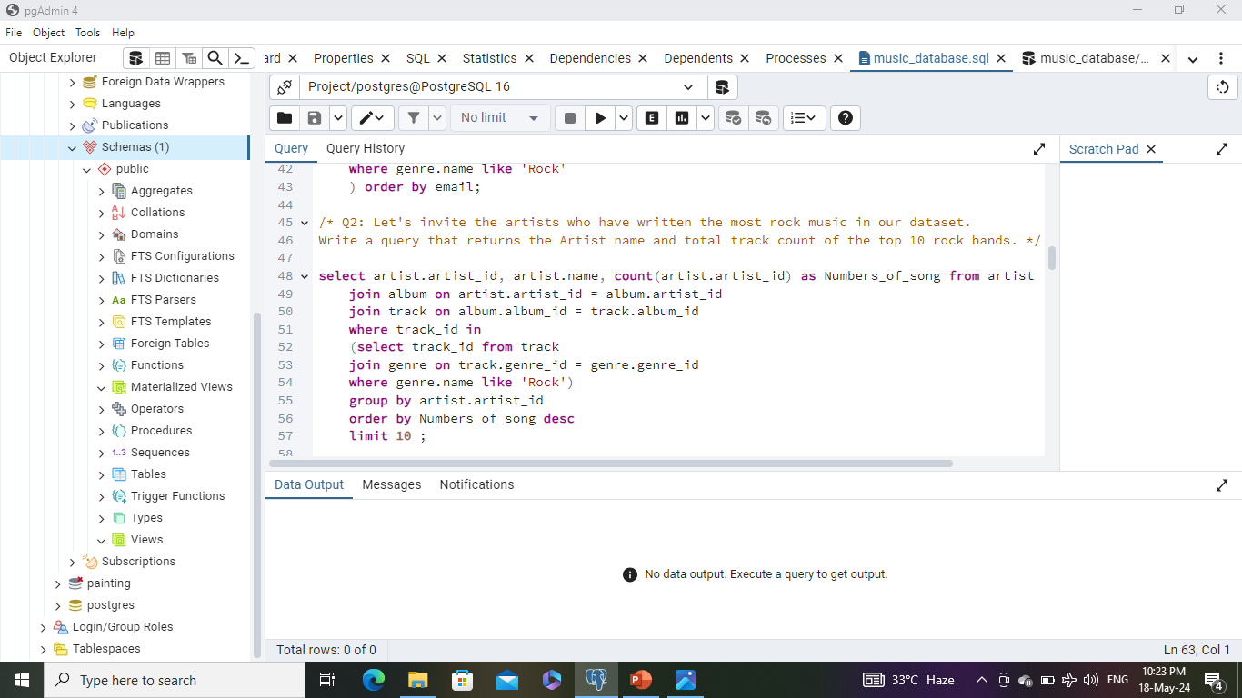
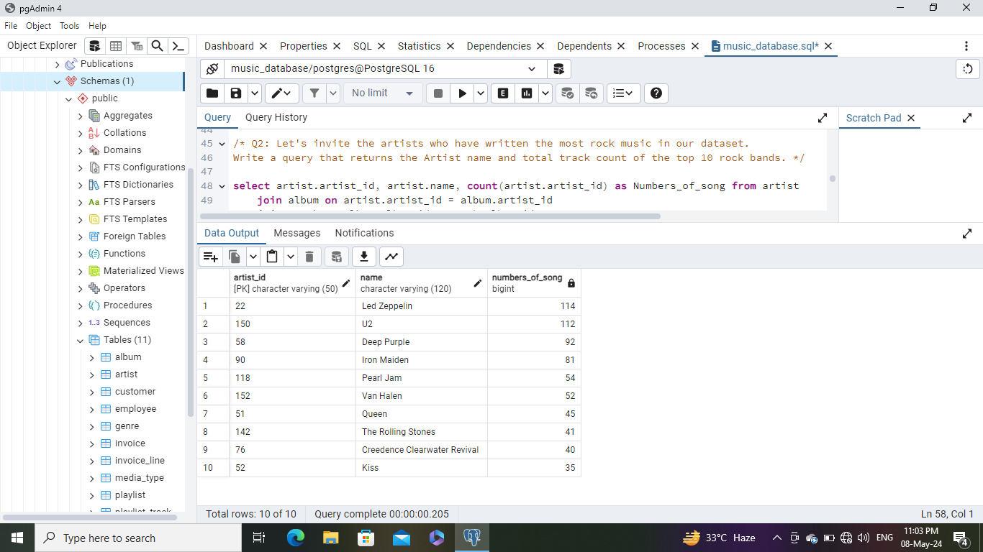
Question Set 2 - Moderate
2: Let's invite the artists who have written the most rock music in our dataset. Write a query that returns the Artist name and total track count of the top 10 rock bands.
Query-
Out Put-

Slide 10
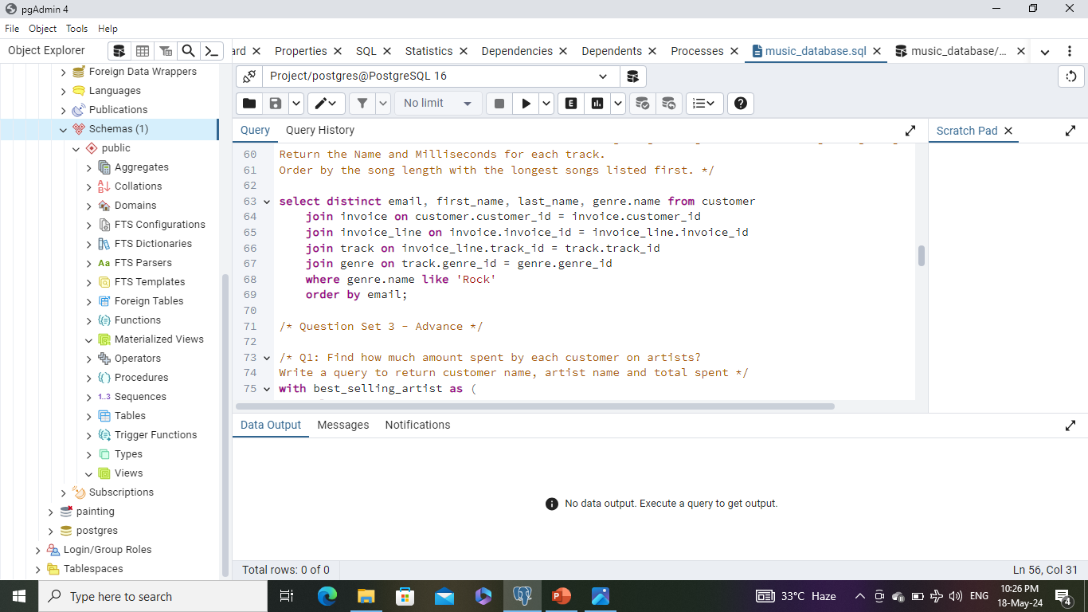
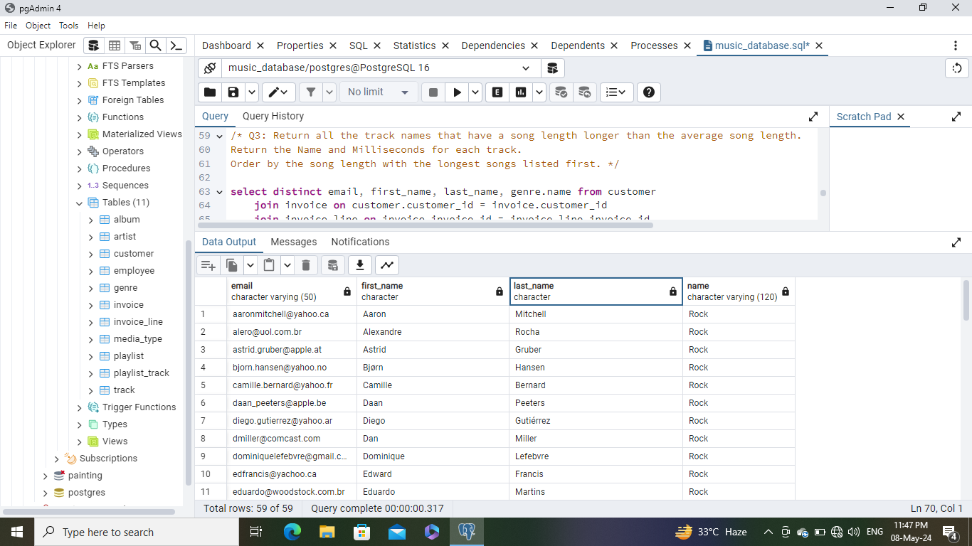
Question Set 2 - Moderate
3: Return all the track names that have a song length longer than the average song length. Return the Name and Milliseconds for each track. Order by the song length with the longest songs listed first.
Query-
Out Put-

Slide 11
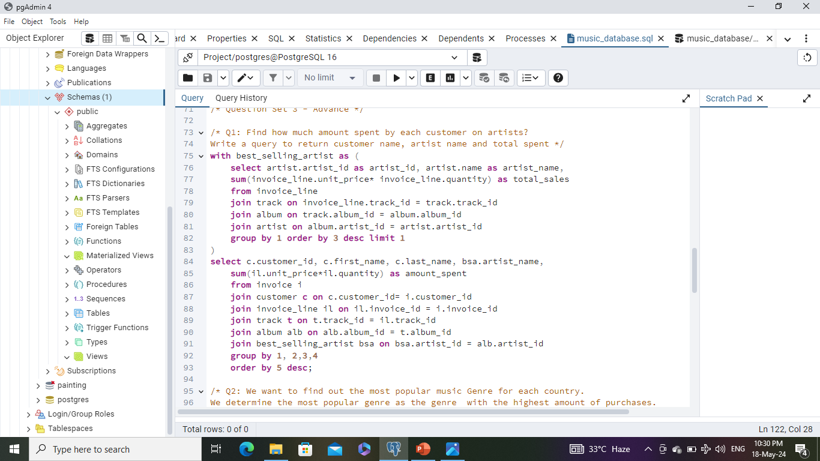
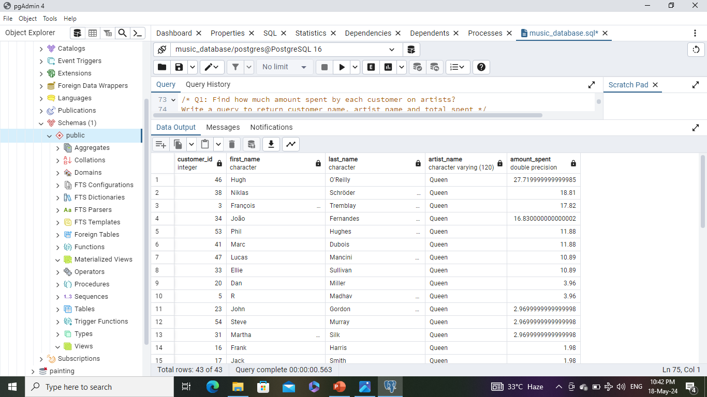
Question Set 3 - Advance
1: Find how much amount spent by each customer on artists?Write a query to return customer name, artist name and total spent.
Query-
Out Put-

Slide 12
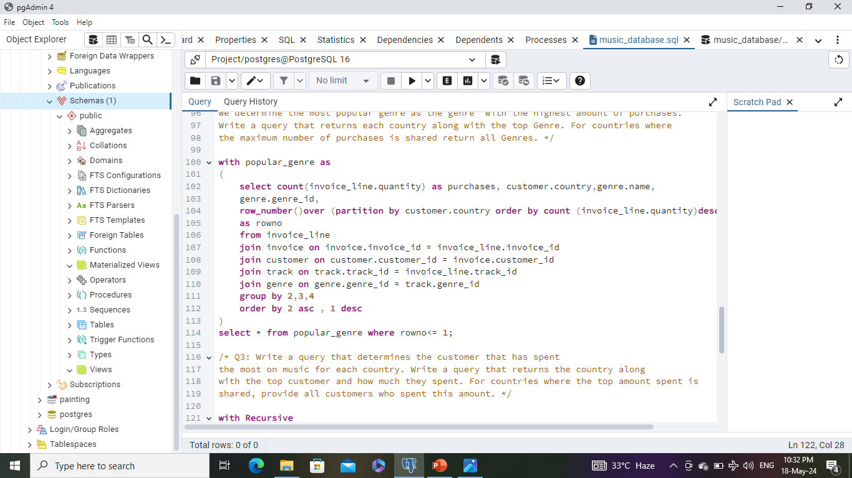
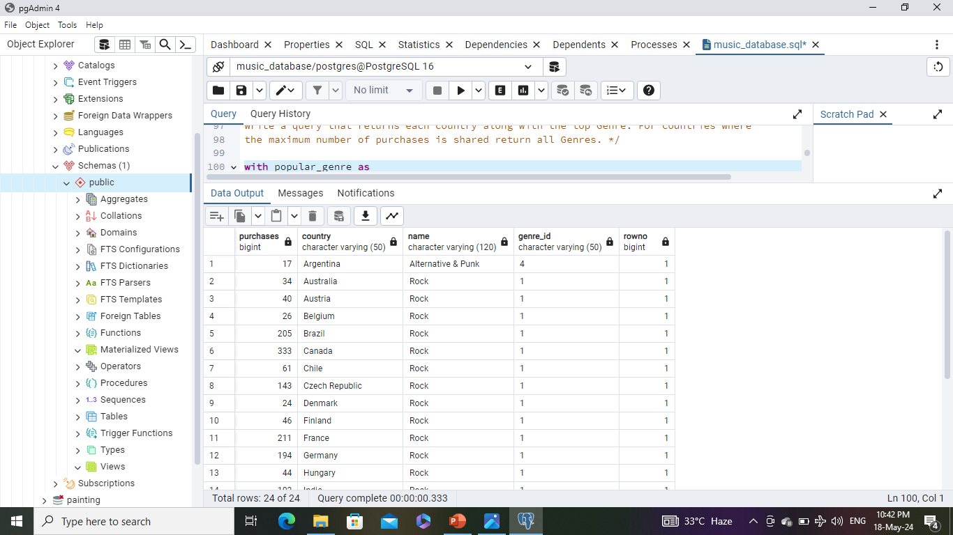
Question Set 3 - Advance
2: We want to find out the most popular music Genre for each country. We determine the most popular genre as the genre with the highest amount of purchases. Write a query that returns each country along with the top Genre. For countries where the maximum number of purchases is shared return all Genres.
Query-
Out Put-

Slide 13
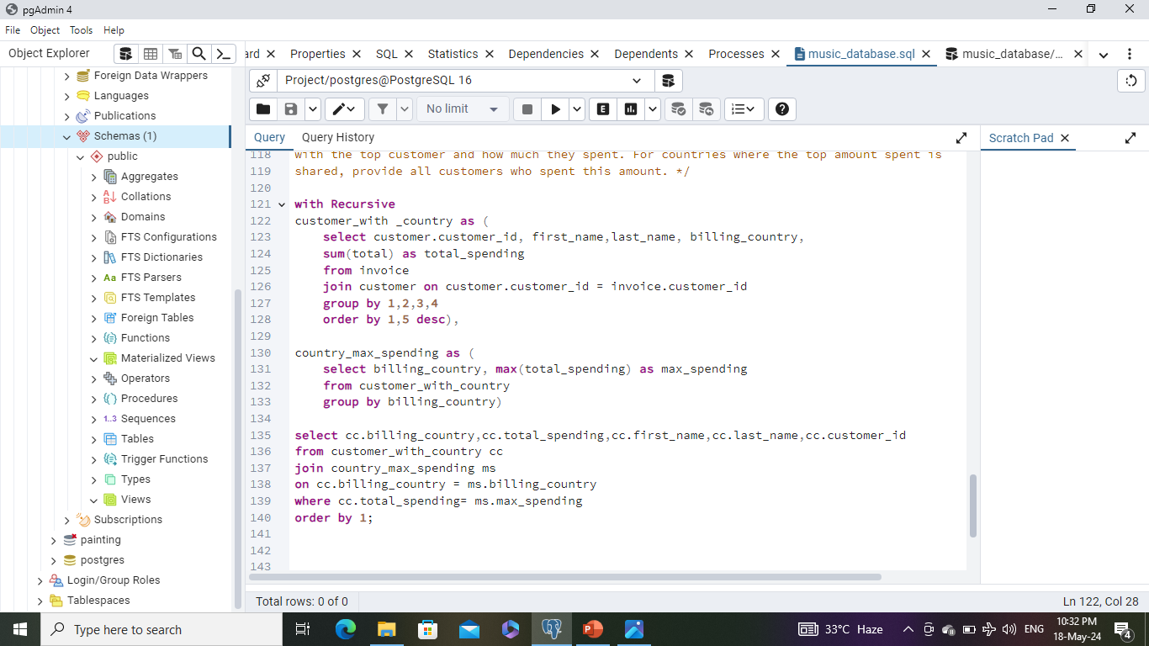
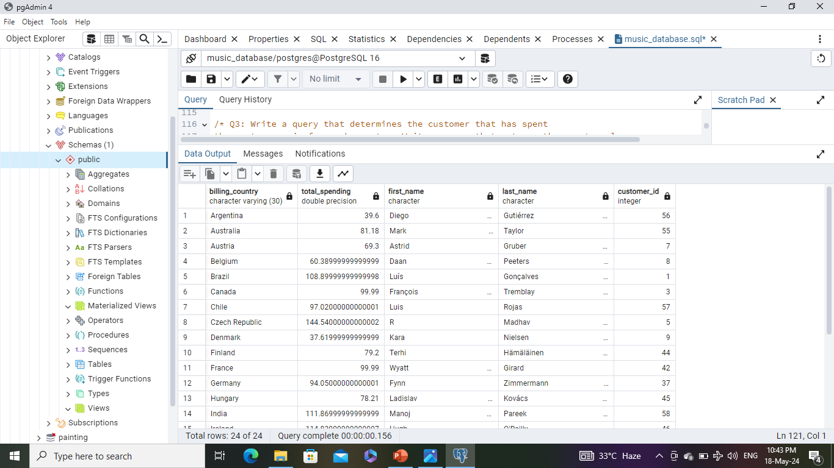
Question Set 3 - Advance
3: Write a query that determines the customer that has spentthe most on music for each country. Write a query that returns the country along with the top customer and how much they spent. For countries where the top amount spent is shared, provide all customers who spent this amount.
Query-
Out Put-

Slide 14

Prepared by – Vikas kumar Maurya
SPECIAL THANKS TO RISHABH MISHRA SIR FOR HIS EXCEPTIONAL GUIDANCE AND INVALUABLE SUPPORT THROUGHOUT THIS PROJECT.
GUIDED BY – RISHABH MISHRA

